Slide 1
Age estimation using DNA methylation data
Michael Molloy

Slide 2
Overview
Background
Objectives and significance of research
Data
Methods
Results
Discussion
Conclusion

Slide 3
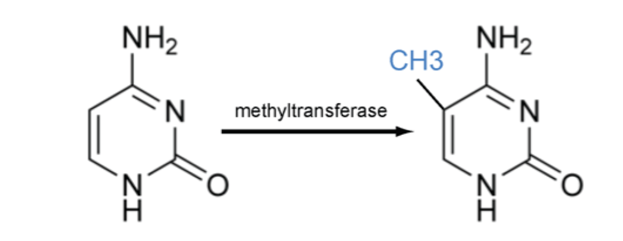

Methylation
1)

Slide 4
Landmark studies
Hyen et al. (2012) researched the epigenetic difference in methylation profiles of a newborn child and a 103-year-old man
Hannum et al. (2013) explored the link between chronological age and DNA methylation.

Slide 5
Objectives and significance of research
Create an epigenetic clock model
Compare the performance of elastic-net model to neural network models
Compare PCA and UMAP dimensionality reduction techniques
Applicable to diet and lifestyle research

Slide 6
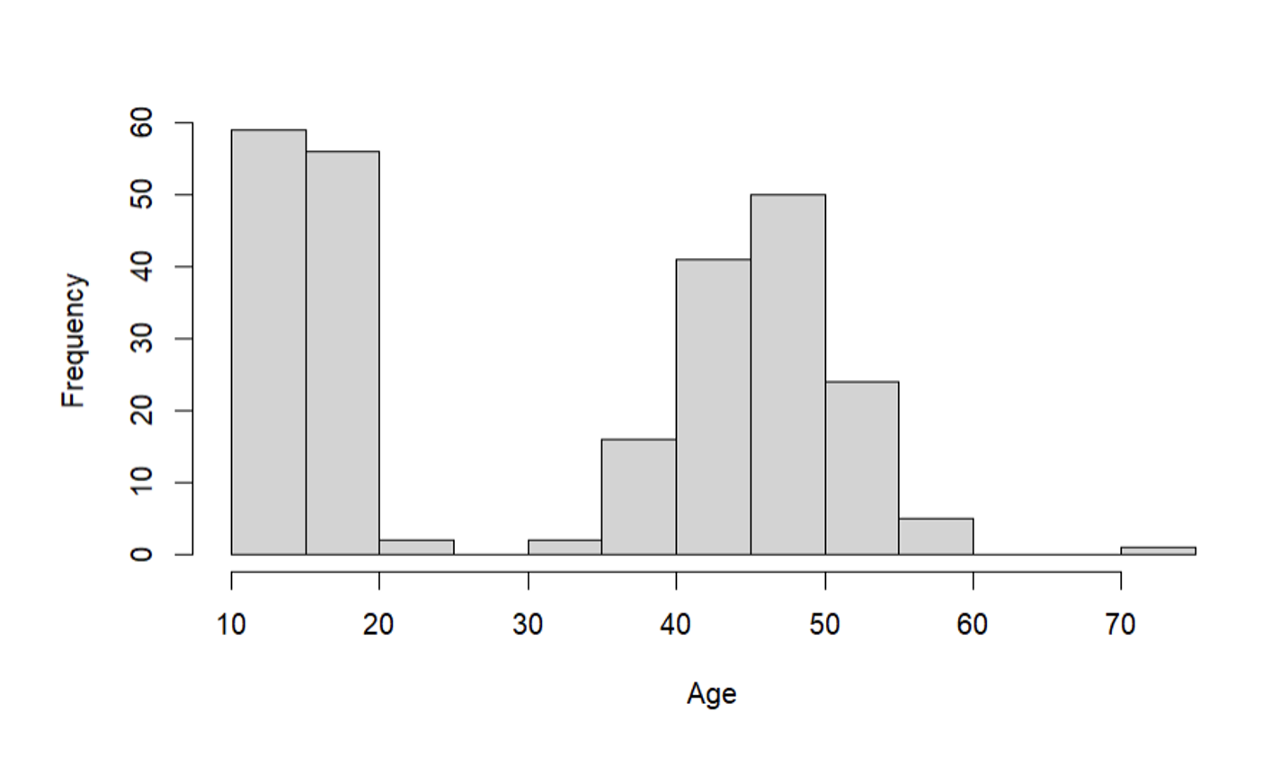
Data
Data sourced from Powell et al. (2012) study
Twin peaks represent the parents and children in the original study
Samples were assumed to be independent
257 samples with ages from 10-75
Age distribution

Slide 7
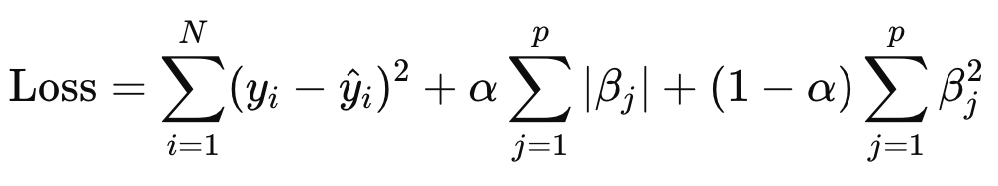
Elastic-net regression
Hybrid regression technique
Loss function is minimised to train the model
The Lasso penalty is the sum of parameter weights
The Ridge penalty is the sum of the squared parameter weights
RSS term
Lasso penalty
Ridge penalty

Slide 8
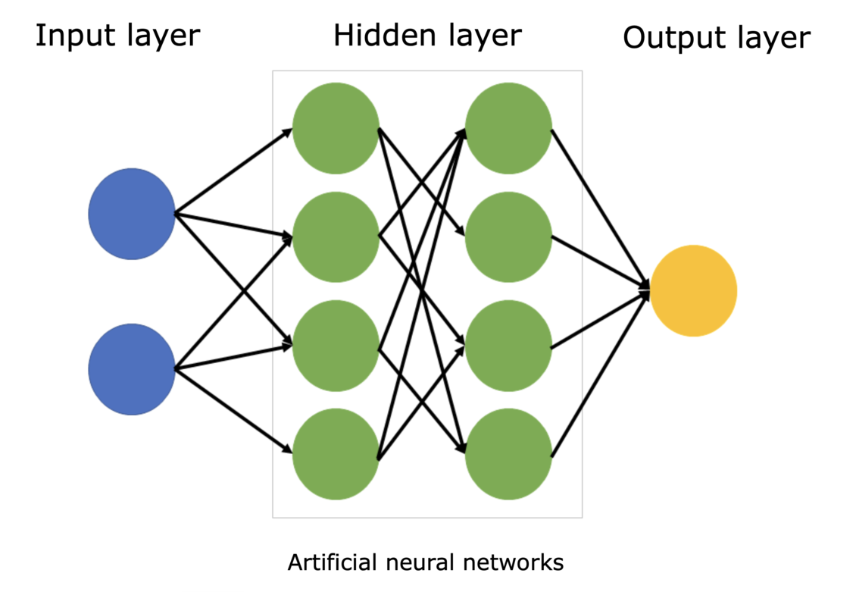
Neural network
The implemented neural networks both included 5 hidden layers with each layer reducing in size until the output layer
Dropout regularisation was used to prevent overfitting
2)

Slide 9
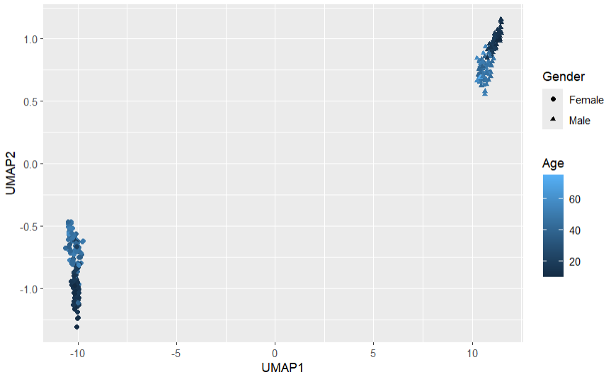
UMAP plot

Slide 10
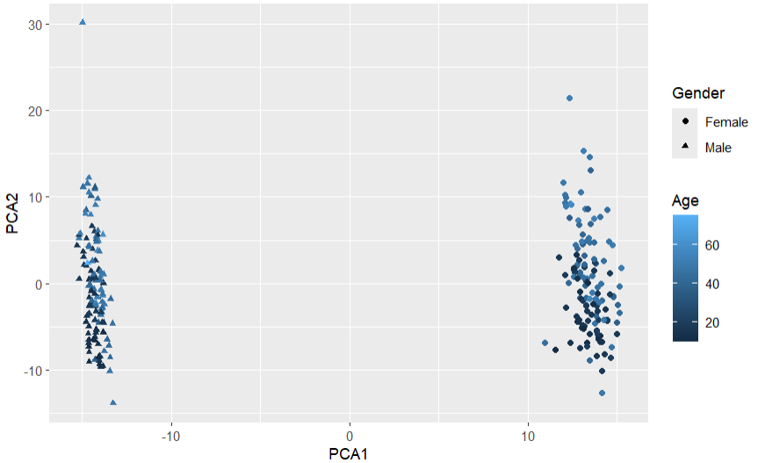
Pca plot

Slide 11
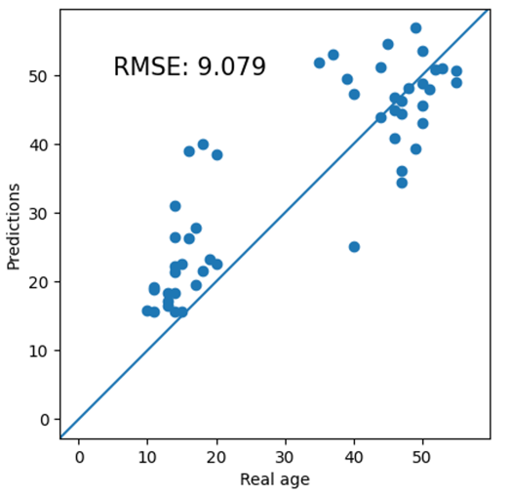
UMAP neural-net accuracy
16 UMAP components
5 hidden layer neural network with three 20% dropout layers in between hidden layers
Performed poorly in both age cohorts
Standard error of 9.08 years

Slide 12
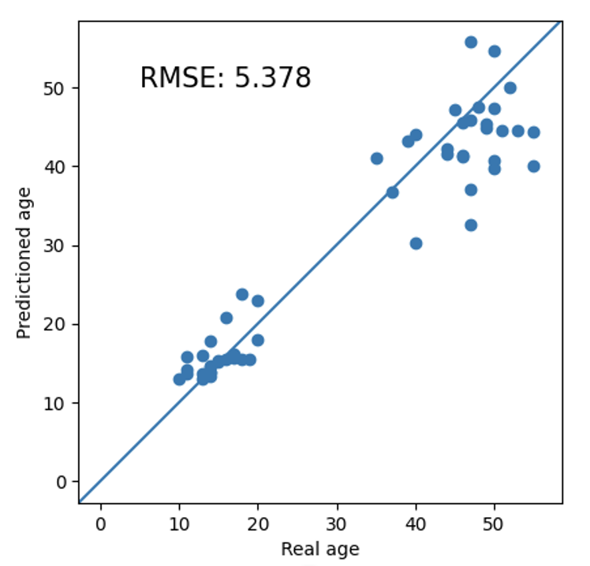
PCA neural-net accuracy
60 PCA components
Performed accurately in the younger cohort
Accuracy reduced significantly in the older cohort
Standard error of 5.38 years

Slide 13
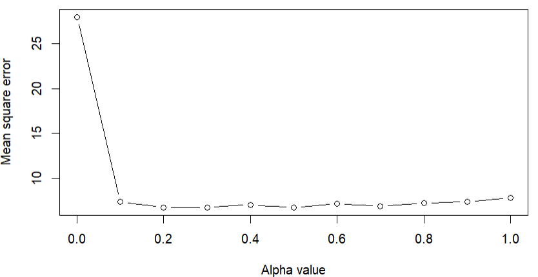
Elastic-net training

Slide 14
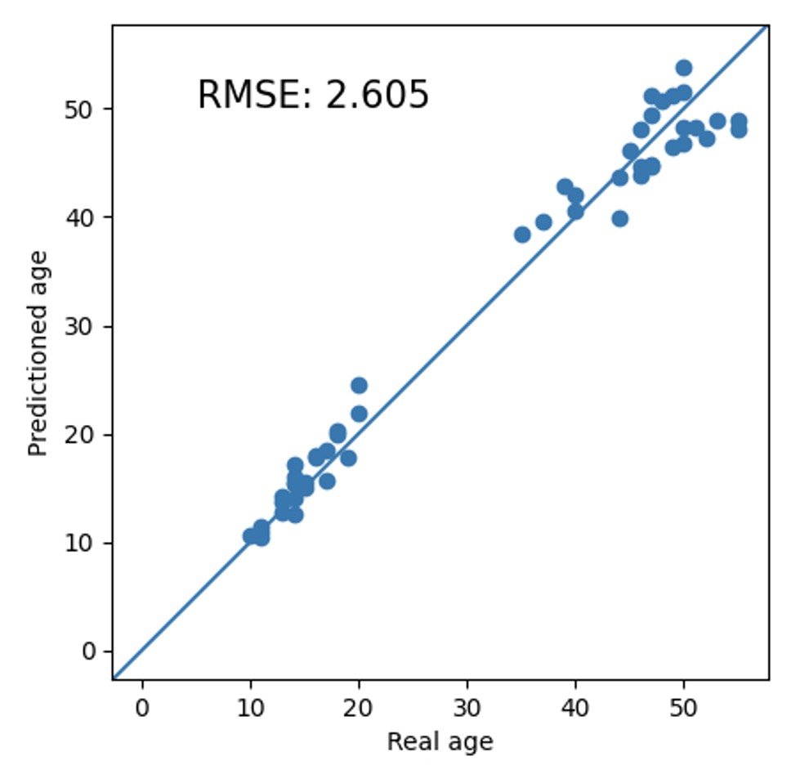
Elastic-net accuracy
102 methylation markers
An alpha value of 0.5 was used to train the model
Performed very accurately in the younger cohort
Accuracy reduced slightly in the older cohort
Standard error of 2.61 years

Slide 15
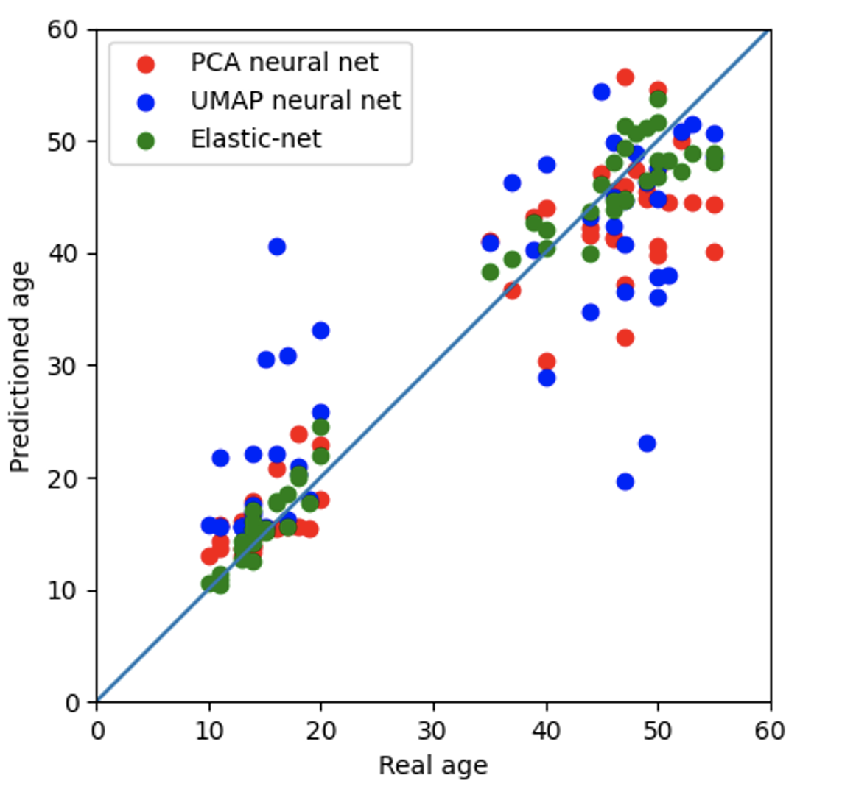
All models compared

Slide 16
conclusion
Elastic-net model is superior:
High prediction accuracy
Reproducibility of results
Model implementation
Model training
Parameter optimization
Interpretability of the final model

Slide 17
Questions?

Slide 18
References
Zou, Hui, and Trevor Hastie. 2005. “Regularization and Variable Selection via the Elastic Net.” Journal of the Royal Statistical Society: Series B (Statistical Methodology) 67 (2): 301–20. https://doi.org/10.1111/j.1467-9868.2005.00503.x
2. “Neural Network Diagram.” 2023. Science Learning Hub. March 14, 2023. https://www.sciencelearn.org.nz/images/5156-neural-network-diagram.

